Slide 1
Cluster detection using unsupervised
machine learning
CMS ML: 20/01/2023

Slide 2
Content
Introduction
About Data
Algorithm Design
Overall Design
K-Means Algorithm
Results
Next Steps

Slide 3
Introduction
Clusters identification for different types particle through their calorimeter measurements is a topic of interest for high energy physicists.
Current algorithm employ knowledge based priors to power their inference.
Does machine learning provide us with significant advantage for this detection task?

Slide 4
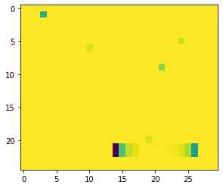
About Data
Generated a script to emulate ECAL and HCAL data given number of events desired
Events = 10000 for the experiment
Binarized Image Representation of ECAL energy measurement

Slide 5
Algorithm Design
Algorithm:
Process Energy Snapshot to a grayscale 2D Image and flatten
Implement K-Means over the data obtained in previous step
Re-label the obtained result to background and signal (Two class)
Iteratively cluster the data based the resulting data based on pixel-pixel connection and form new cluster ids
Unsupervised Algorithm

Slide 6
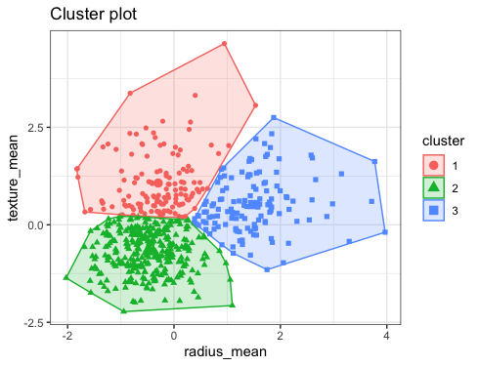
K-Means Algorithm
Aggregates data into clusters based on similarity based on a property
In our case the property is measured value.
Algorithms:
Select K random centroids (K=4)
Assign points to nearest cluster centroid based on Euclidean distance
Reinitialize centroids using average if data points for each cluster
Repeat b & c till convergence

Slide 7
Results
Threshold = 3 (if 3 pixels are missing or extra)
Total Clusters = 19921
Correctly classified = 12660
Incorrect Detection = 7269
Threshold Mismatch = 6109
False Negatives = 1160
False Positives = 0
Incorrect detection mostly pertain to examples with correctly located shorter clusters as false positive are zero
Inference time ~0.012 sec/event

Slide 8
Results
Threshold = 2 (if 2 pixels are missing or extra)
Total Clusters = 19921
Correctly classified = 8356
Incorrect Detection = 11565
Threshold Mismatch = 10409
False Negatives = 1156
False Positives = 0
Incorrect detection mostly pertain to examples with correctly located shorter clusters as false positive are zero

Slide 9
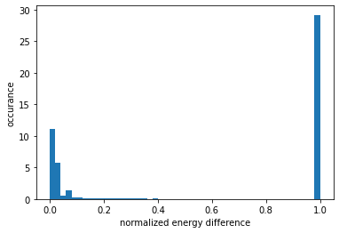
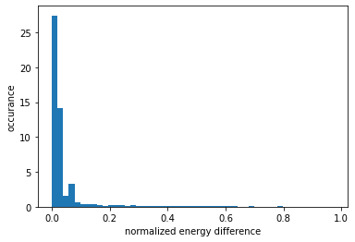
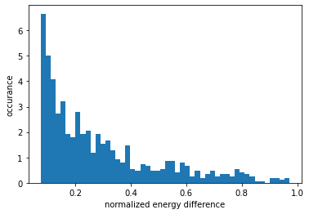
Results
Normalized Energy Difference Histogram (thresh=2)

Slide 10
Next Steps:
Issues with Edge Cases to be resolved
Ep of cluster by algorithm is greater than Et of MC Truth in very few cases. This happens when two clusters are overlapping and hence seem like a single large cluster for the pixel-pixel join operation
Thresholding Strategy
Displacement not considered
Hadron deposits need to calculated separately for resolution (currently considering all as a single unit)
Alternate K Means:
Distance-wise Algorithm + ELBO based K search
Distance-wise Algorithm + K estimation based on prior

